Slide 1
Lecture 2
Gradient Descent, Perceptron, Neural Networks

Slide 2
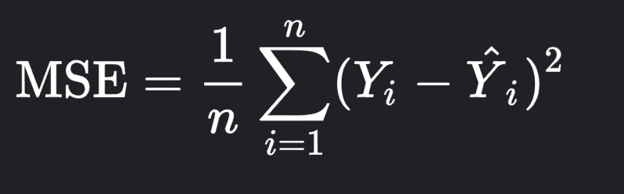
Recall From Last Week
In our linear regression problem, our loss function was given as such
The goal is to minimize this loss function

Slide 3
Gradient Descent

Slide 4
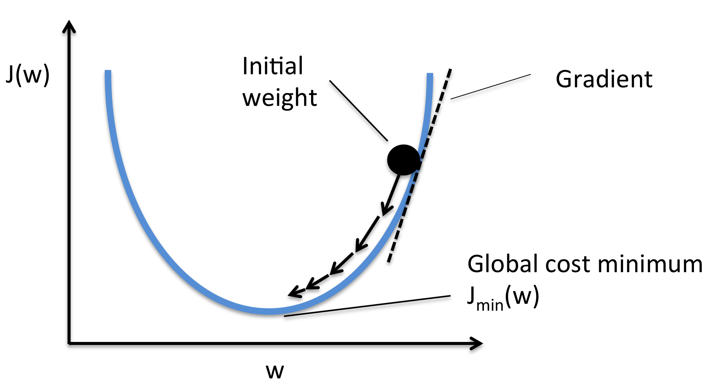
What is a Gradient?
In multivariable calculus, the gradient is a vector in the direction of the steepest slope.
Imagine our loss function as a curve in a 3D space. If we keep moving in the direction of the gradient, we will reach the minimum loss

Slide 5
Try This!
https://uclaacm.github.io/gradient-descent-visualiser/#playground

Slide 6
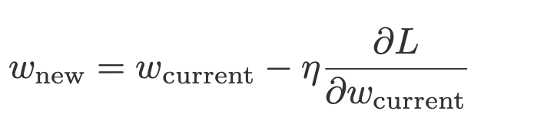
Updating the Weights
The process of updating the partial derivatives and updating the weights is called backpropagation

Slide 7
Perceptron

Slide 8
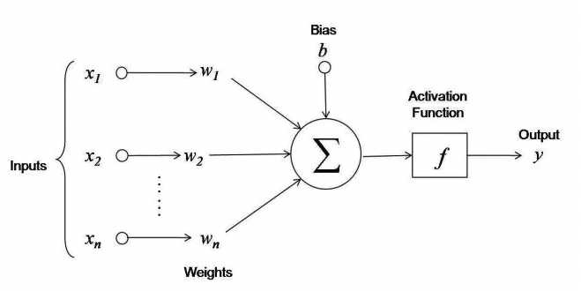
The Perceptron
Each input variable is multiplied by a weight and added together with a bias term
This output value is then put into an activation function

Slide 9
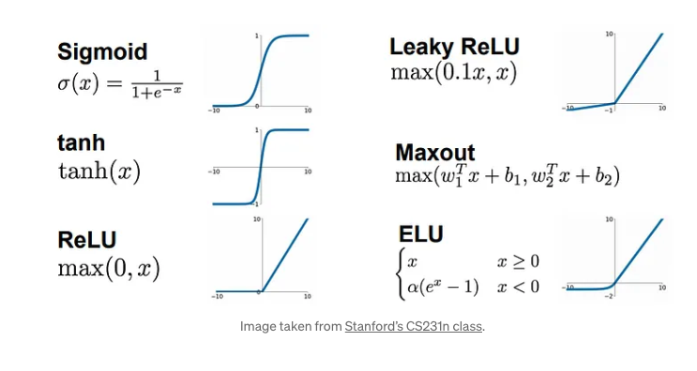
Activation Function
Adds nonlinearity to our output
Without it, adding more layers to a network would mean nothing

Slide 10
Forward Propagation
2
5
1
3
???
-3
1
2
4

Slide 11
Forward Propagation Solution 1
2
5
1
3
???
-3
1
2
4
19
19

Slide 12
Forward Propagation Solution 2
2
5
-2
0
1
3
???
-3
1
2
4
19
19

Slide 13
Forward Propagation Full Solution
2
5
-2
0
1
3
38
38
38
-3
1
2
4
19
19

Slide 14
The Neural Network
Also known as the multilayer perceptron

Slide 15
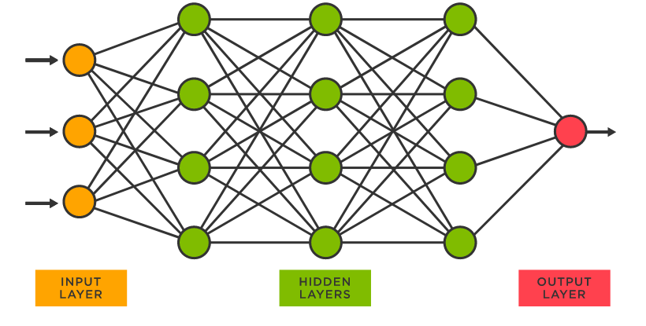
The Neural Network
The simplest neural network is just a collection of perceptrons
Consists of an input layer, hidden layers, and an output layer
Same loss function and goal, minimize the loss function

Slide 16
Working with Neural Networks
Refresher: There is a train set, a validation set, and a test set
1st: Randomly split your dataset into these three sets, usually with a 60-20-20 split
Fit the model with the train data and use the validation data as intermediate benchmarks
Report the findings of the unseen test data

Slide 17
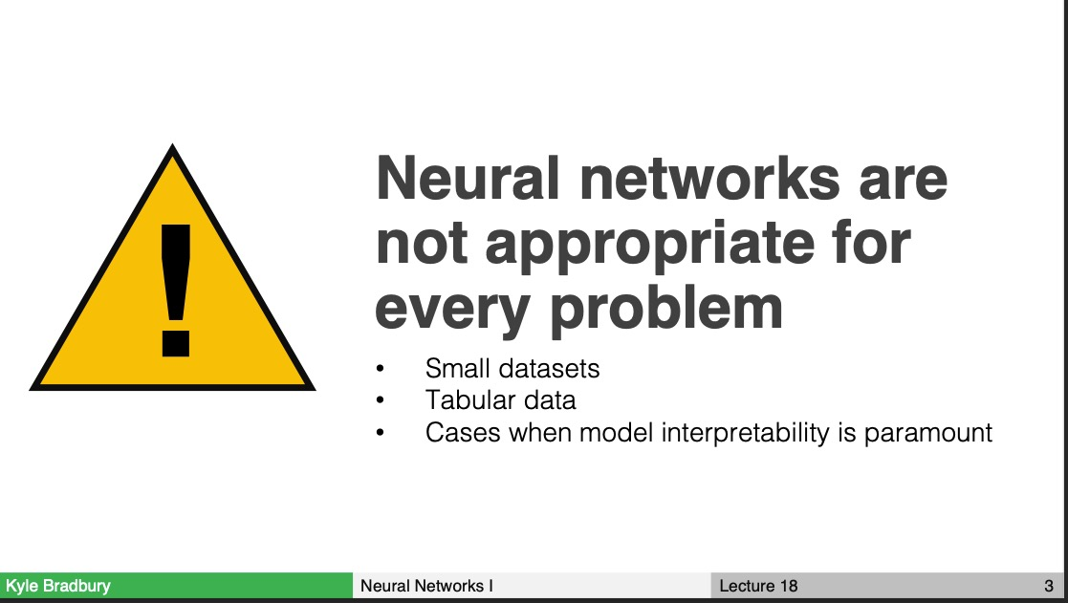
https://kylebradbury.github.io/ids705/syllabus.html

Slide 18

Now You Try!!

